Slide 1
MUSHROOM CLASSIFICATION:
CAN WE EAT IT?
Last Updated: 30/11/2017
Notes:
Master Image Source: http://static5.uk.businessinsider.com/image/589b4226dd0895dc6e8b49ea/psychedelic-drugs-like-magic-mushrooms-and-lsd-have-key-differences--heres-what-you-should-know.jpg

Slide 2
Abstract
In this study we explored UCI’s mushroom classification dataset, our main research objective was to try to build a model that could predict which mushrooms are edible and which ones are not given a set of features.
Using AdaBoost we were able to build highly effective model; we can predict the edibility of mushrooms with 99% accuracy using just seven (out of twenty-two) features.
The most predictive feature of whether a mushroom is poisonous or not turns out to be its odor; smells like almonds? Eat Away! Smells like creosote? Don’t!

Slide 3
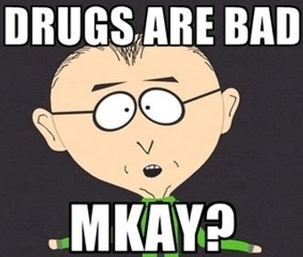
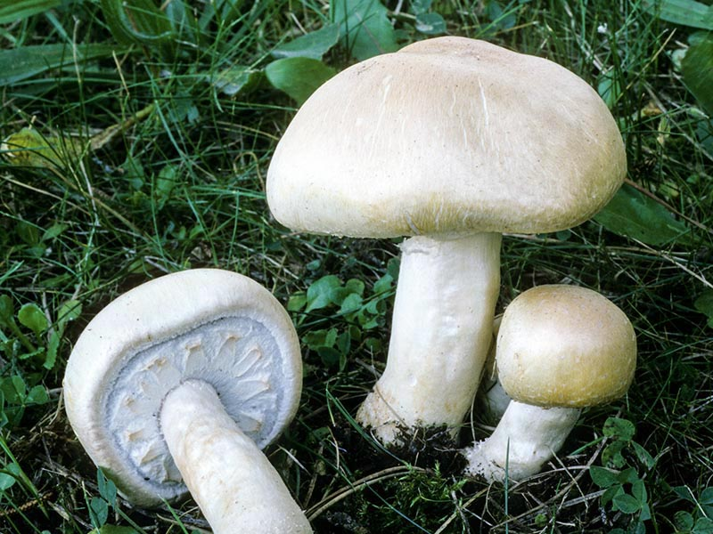
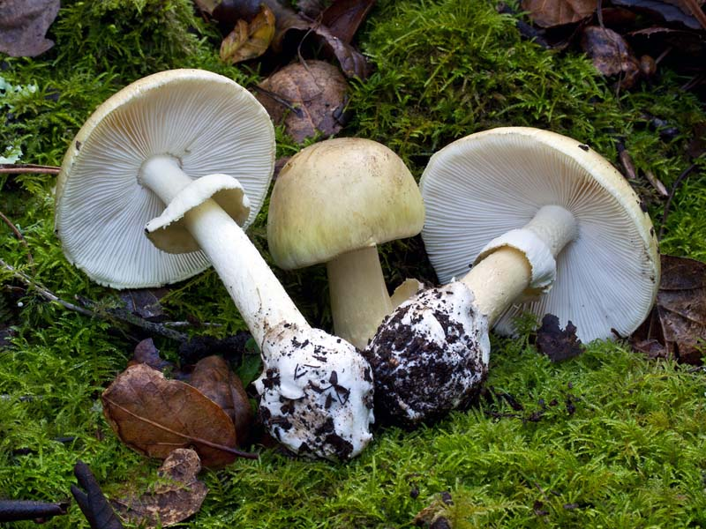
Motivation & Research Questions
We want to build a model that can reliably tell us which mushrooms are edible. Moreover, an additional aim of this research is to see if it is possible to translate the results of the model into actionable advice. In other words, can we create useful ‘rules of thumb’ that could help human beings easily and quickly identify edible mushrooms? Such information could be useful if an individual were to find themselves in a survival situation. Or maybe it will help a feckless hippie not mistake psychedelic mushrooms for death caps?
Research Questions:
Can we build a model that reliably predict whether a mushroom is likely to be poisonous?
(i) What features (if any) are the strongest predictors of whether a mushroom is edible.(ii) Can we turn these insights into useful, actionable, information?
Agaricus fissuratus (horse mushroom), edible.
Amanita phalloides (death cap), extremely poisonous.
Notes:
Image: Mr Mackey (Southpark): https://i.ytimg.com/vi/IdoAz2X1jRI/hqdefault.jpg
Image: horse mushroom, (Photo: © Fred Stevens), http://www.mykoweb.com/CAF/species/Agaricus_fissuratus.html
Image: Deathcap, (Photo: © Michael Wood), http://www.mykoweb.com/CAF/species/Amanita_phalloides.html

Slide 4
A Super Quick Guide to Mushrooms
The mushroom database we are using contains just over twenty features (e.g ‘cap shape’, ‘gill spacing’, etc). In order to understand our data it would be prudent to spend a bit of time familiarizing ourselves with mushrooms. The next two slides intend to do exactly that, we shall (very briefly) cover the anatomy of a mushroom and illustrate the various gill shapes, cap shapes and so on.

Slide 5
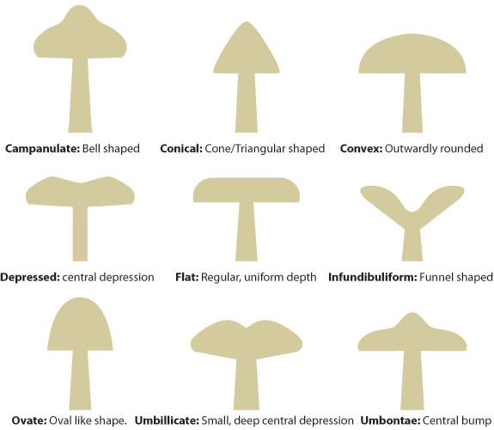
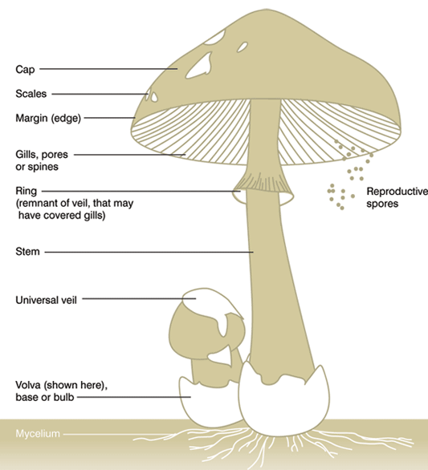
Anatomy of a Mushroom
MUSHROOM 101: Anatomy & Cap Shape
Example Cap Shapes:
Notes:
Anatomy Image: https://i0.wp.com/www.mushroomdiary.co.uk/wp-content/uploads/2011/09/parts-of-a-mushroom.gif
Cap Shape Image: https://i0.wp.com/www.mushroomdiary.co.uk/wp-content/uploads/2011/08/cap-shapes.gif

Slide 6
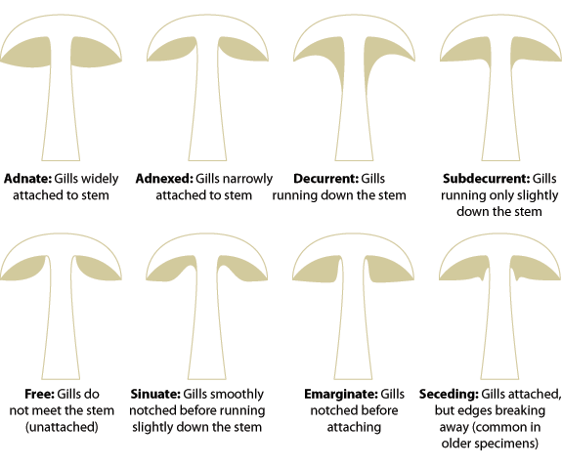
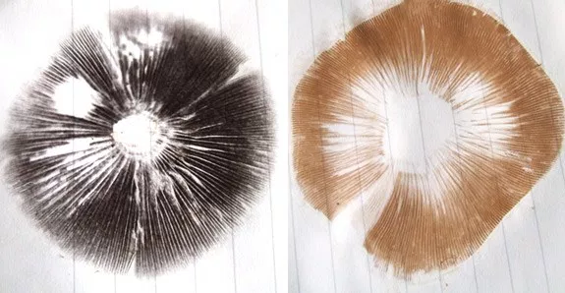
MUSHROOM 101: Spore Print & Gill Attachment
Example Gill Attachment:
“The spore print is the powdery deposit obtained by allowing spores of a fungal fruit body to fall onto a surface underneath.” (Spore Print Wikipedia Page)
Below we have an example of a ‘chocolate-coloured’ print (left) and a ‘brown-coloured’ print (right).
Notes:
Gill Attachment Image: https://i1.wp.com/www.mushroomdiary.co.uk/wp-content/uploads/2011/08/gill-attachments.gif
Spore Print Image: https://i2.wp.com/www.mushroomdiary.co.uk/wp-content/uploads/2011/09/spore-prints.jpg

Slide 7
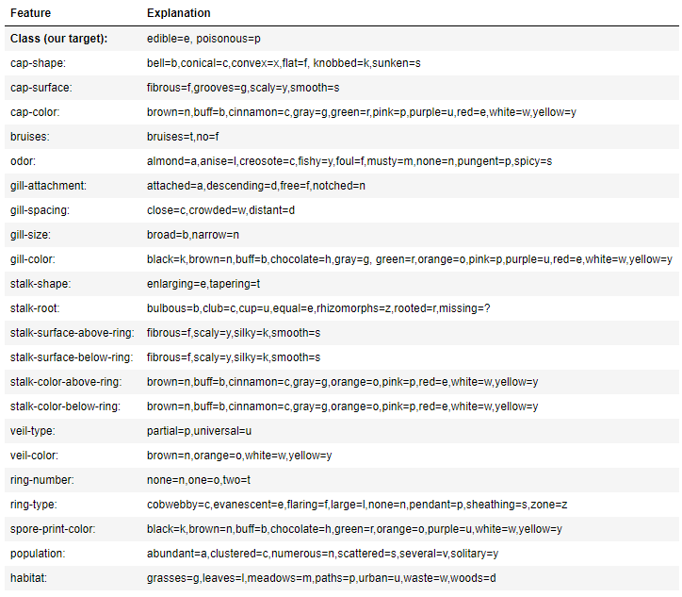
Dataset
For this analysis we shall be using UCI’s Mushroom Classification dataset. This dataset is hosted on Kaggle: https://www.kaggle.com/uciml/mushroom-classification
The dataset contains just over twenty features (ALL features are categorical) and 8000+ entries. The table directly below names all features and explains the possible values of said features (Class being our ‘target’ variable).

Slide 8
Data Preparation and Cleaning
The first step was to explore the data, removing null values and features that didn’t seem useful. For example, in the features table (previous slide) you would have observed that ‘Veil Type’ has two possibilities. However, when we examine the data it turns out that all mushrooms have the value (P). Ergo this feature wasn’t predictive of anything and was thus removed.
The second step take was to convert all the categorical features into numerical data. For example, the feature ‘Veil-color’ has the possible values “Brown, Orange, White, Yellow” which was encoded as 0,1,2,3 respectively. Similarly the mushroom ‘class’ label (edible/poisonous) was encoded as 0, 1.
The table below shows us that we have 4208 edible mushrooms in the dataset and only eight mushrooms in the entire dataset have yellow coloured veils.
The next steps taken were to save the ‘class’ column separately from that the dataset and then split the data into a test and training set.
FEATURE | VALUES
Veil Type | Partial (P) | Universal (U)
FEATURE | 0 | 1 | 2 | 3
Class | 4208 | 3916 | - | -
veil-color | 96 | 96 | 7924 | 8
Notes:
Source: Juypter Notebook (see references)

Slide 9
Methods: Overview
In this analysis we decided to use the AdaBoost classifier, Adaboost was chosen because it is one of the best ‘out of the box’ classifiers and often does not require significant parameter tuning to get decent results.
The model was run several times with varying test/train splits, random states and number of estimators. In fact, we were able to get 100% accuracy when using twenty estimators. However the model we ended up choosing used eleven classifiers. This choice was due to concerns of ‘over-fitting’ and a general preference for a simpler model. As a side note, using just three estimators was sufficient to get an accuracy score of 86%.

Slide 10
Methods: Model Parameters
SKlearn Test Train Split Parameters
Test Size | 0.4
Random State | 90324372
0.99015384615384616
AdaBoost Classifier Parameters
Algorithm | SAMME.R
Learning Rate | 1.0
Number of Estimators | 11
Random State | 90324372
Score (on test set) | 0.99015384615384616
What methods did you use to analyze the data and why are they appropriate? Be sure to adequately, but briefly, describe your methods.

Slide 11
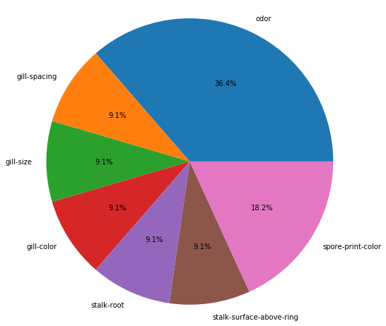
Findings
Our first research question was whether we could build a reliable model for predicting the edibility of mushrooms. The answer to which is a resounding yes; Using AdaBoost we can build a fairly simple model which has 99% accuracy on the test set.
The second research question concerned whether we could figure out the most significant features that predicted edibility. Once again, the answer is yes. The pie chart below shows that our model picked seven features to draw its conclusions from. Of which, the best two features that predict the edibility of mushrooms is ‘Odor’ (36.4% weighting) and the colour of the ‘spore print’ (18.2% weighting).
So this pie chart illustrates that odor is a significant predictor of a mushrooms edibility. However, this chart does not tell us WHAT odors we should associate with edibility. To answer that Question we need to do a bit more digging...
<Feel free to replicate this slide to show multiple findings>
Present your findings. Include at least one visualization in your presentation (feel free to include more). The visualization should be honest, accessible, and elegant for a general audience.
You need not come to a definitive conclusion, but you need to say how your findings relate back to your research question.
Notes:
PieChart Source: Jupyter Notebook

Slide 12
Findings II
The table to the right is simply the counts of all the mushrooms. For example, there are exactly 400 mushrooms in our dataset that have the properties of being both (a) edible and (b) smelling like almonds.
This table also helps explain why we could accurately predict the edibility of mushrooms even when our AdaBoost models used very few estimators. In short, the odor feature is very cleanly separable; ALL mushrooms that smell fishy or foul or of creosote are poisonous. Likewise ALL mushrooms that smell like almonds are edible.
Thus, our third research question (whether we gave give actionable advice) is also answered in the affirmative; If it smells bad, don’t eat it.
 | edible | Poisonous
almond | 400.0 | 0.0
anise | 400.0 | 0.0
creosote | 0.0 | 192.0
fishy | 0.0 | 576.0
foul | 0.0 | 2160.0
musty | 0.0 | 36.0
no smell | 3408.0 | 120.0
pungent | 0.0 | 256.0
spicy | 0.0 | 576.0
Notes:
Table Source: Jupyter Notebook

Slide 13
Findings III
 | edible | poisonous
black | 1648.0 | 224.0
brown | 1744.0 | 224.0
buff | 48.0 | 0.0
chocolate | 48.0 | 1584.0
green | 0.0 | 72.0
orange | 48.0 | 0.0
purple | 48.0 | 0.0
white | 576.0 | 1812.0
yellow | 48.0 | 0.0
The table to the right is the edibility of mushrooms (columns) with spore-print colours (row). And we can see a similar pattern as before, most colours are separable into edible/not edible boxes
For example, 88% of mushrooms with brown spore prints are edible, whereas just 3% of mushrooms with chocolate spore prints are edible.
Notes:
Table Source: Jupyter Notebook

Slide 14
Conclusions
In this study we were able to successfully build a model using machine learning techniques.
The single biggest predictor of whether a mushroom is edible or not is its odor; If it smells like almonds? Eat Away! Smells like creosote? Don’t!
Does the mushroom leave chocolate coloured prints? Don’t risk it. Brown coloured prints? It’s probably safe to eat but you should probably give a sniff before you tuck in!

Slide 15
References
Dataset:
Mushroom classification (UCI Machine Learning) : https://www.kaggle.com/uciml/mushroom-classification
Jupyter Notebook:
Mushrooms! (by me) : https://github.com/fluffy-hamster/Mushroom-Data-Analysis
Images:
Mushrooms (master background): http://static5.uk.businessinsider.com/image/589b4226dd0895dc6e8b49ea/psychedelic-drugs-like-magic-mushrooms-and-lsd-have-key-differences--heres-what-you-should-know.jpg
Mr Mackey (Southpark): https://i.ytimg.com/vi/IdoAz2X1jRI/hqdefault.jpg
Horse mushroom (by Fred Stevens): http://www.mykoweb.com/CAF/species/Agaricus_fissuratus.html
Deathcap (by Michael Wood): http://www.mykoweb.com/CAF/species/Amanita_phalloides.html
Anatomy Image: https://i0.wp.com/www.mushroomdiary.co.uk/wp-content/uploads/2011/09/parts-of-a-mushroom.gif
Cap Shape Image: https://i0.wp.com/www.mushroomdiary.co.uk/wp-content/uploads/2011/08/cap-shapes.gif
Gill Attachment Image: https://i1.wp.com/www.mushroomdiary.co.uk/wp-content/uploads/2011/08/gill-attachments.gif
Spore Print Image: https://i2.wp.com/www.mushroomdiary.co.uk/wp-content/uploads/2011/09/spore-prints.jpg

